Slide 1
Mobile Application Security
Sefa Ozan Application Security Engineer @ Trendyol

Slide 2
AGENDA
Mobile Development Tools
Android Studio
Emulator
Android Debug Bridge (adb)
Static Analysis
Unzipping
Decompiling
Android App Components
Activity
Broadcast Receiver
Services
Content Provider
Deep/App Links
Mobile Game Hacking
Hacking a clicker mobile app
Runtime Manipulation
Learning Frida

Slide 3
Mobile Development Tools
Android Studio
Emulator
Android Debug Bridge (adb)

Slide 4
Static Analysis of An APK
Unzipping
Decompilation

Slide 5
AndroidManifest.xml
Package name,
Version name,
Permissions,
Components (activity, service, content provider, broadcast receiver),
Deep link
https://github.com/dark-warlord14/ovaa/releases/download/1.0/ovaa-debug.apk

Slide 6
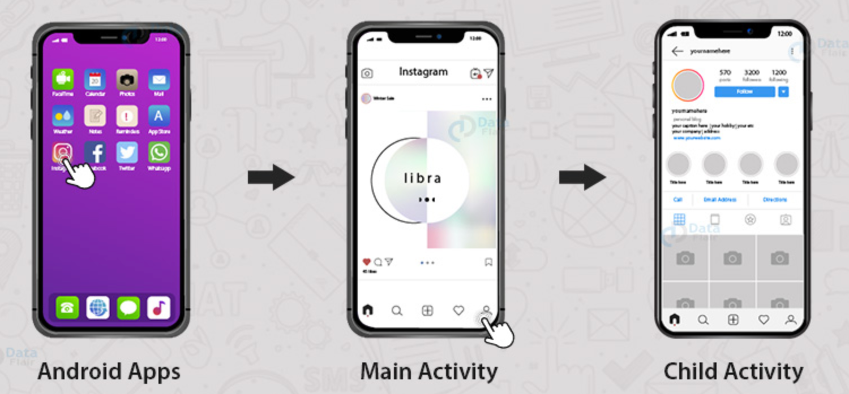
Activity

Slide 7
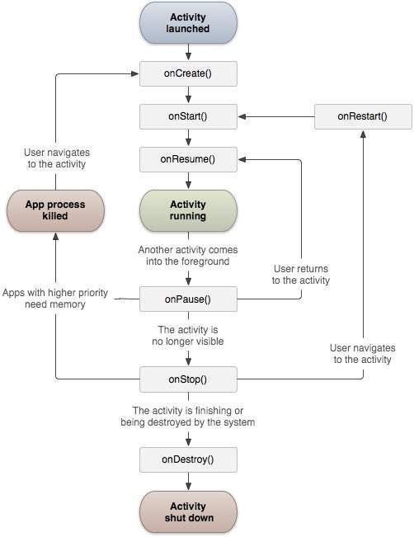
Activity Lifecycle

Slide 8
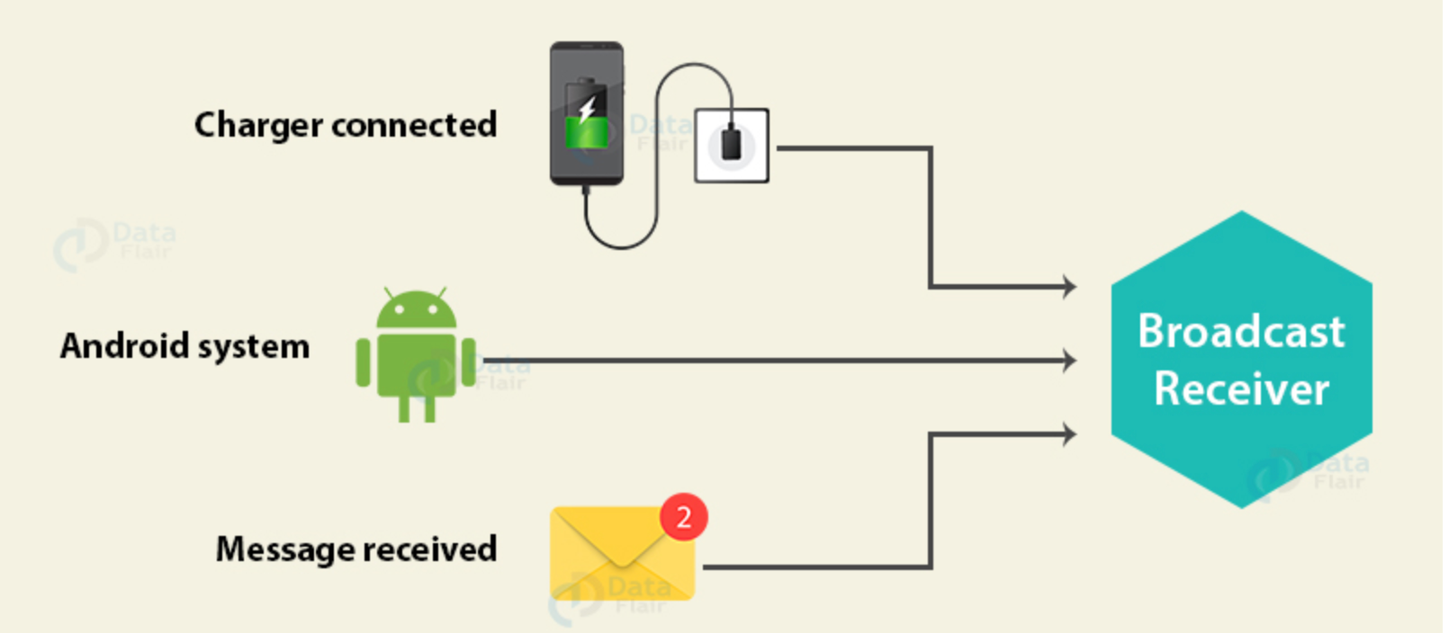
Broadcast Receiver

Slide 9
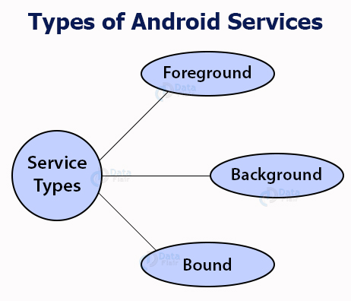
Service

Slide 10
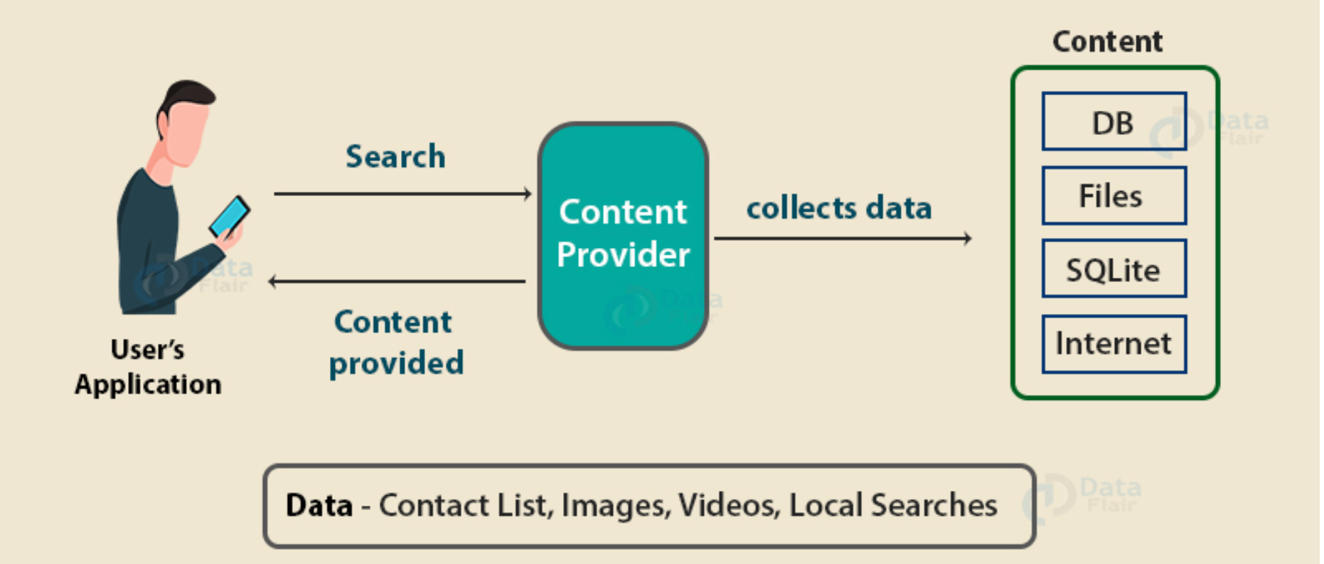
Content Provider

Slide 11
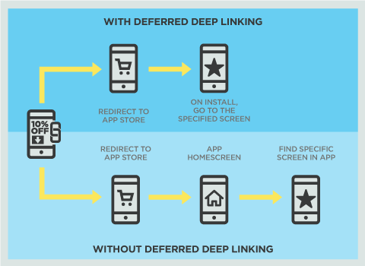
Deep Link

Slide 12
Damn Insecure And Vulnerable App (Diva)
https://github.com/0xArab/diva-apk-file

Slide 13
Mobile Game Hacking
https://github.com/absosec/mobile-security-training-apps/blob/main/clicking_game.apk

Slide 14
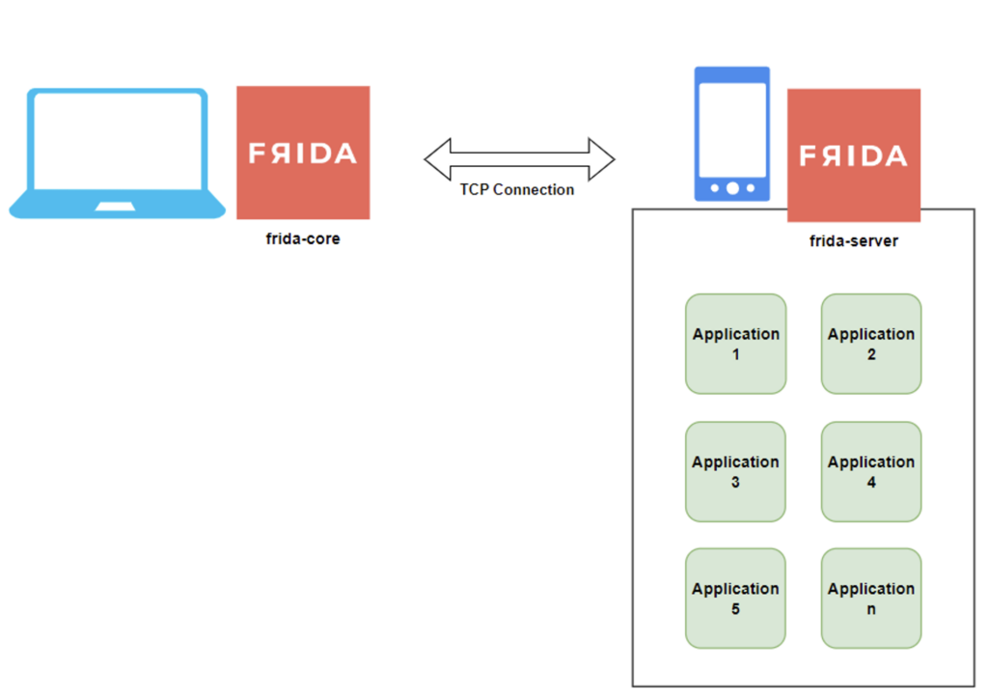
Frida

Slide 15
Frida
Hook methods
Override method implementations
Read and modify arguments / return values
Call methods manually
Create new object instances
Inspect and change fields
Hook constructors and overloads
Bypass runtime security controls
https://github.com/absosec/mobile-security-training-apps/blob/main/Privacyfriendlydicer.apk
https://github.com/absosec/mobile-security-training-apps/blob/main/fridaFunc.apk
https://github.com/absosec/mobile-security-training-apps/blob/main/RootCheck.apk

Slide 16
Space Peng
HighScore
Lives
Rapid Fire
Invisible
Coin Rain
UnCollidable
New Player
https://github.com/absosec/mobile-security-training-apps/blob/main/spacepeng.apk

